Slide 1
A Project by : Gurudas Premdas Chavan (2021BCS037) Pravin Pralhadrao Narwade (2021BCS047) Rahul Pramod Chafle (2021BCS061) Under The Guidance Of : Mr. Rupesh Sonkamble Ms Misha Nihalani
ALUMNI INFORMATION SYSTEM

Slide 2
CONTENTS
Abstract
Research Problem and Solution
E-R Diagram
Use Case Diagram
Modules Used
Admin Side and User Side Interface
Functionality
Technology Used
Conclusion & Future Scope

Slide 3
ABSTRACT
The aim of this Alumni Information System Project is to construct a system that will
be able to store the information of an institution, college, schools.
Connections with Alumni’s can be used to gain orientations and vision to the students.
It is a step towards this, creating multidimensional interactions between current and past students of college, also provides all the details about Alumni and event which organized by college.
The project mange the fresh as well as old graduate students with their respective information in actively participating in making registering, searching, managing the alumni informationfor sharing their expertise, network, jobs opportunities and resources.
Keywords : Alumni, System, Student, Management, Dashboard etc.

Slide 4
Problem Statement
In "Internet+" era, how to collect, excavate and utilize alumni resources is one of the most important management work for colleges and universities.
Solution
The design and implementation of the ALUMNI Dashboard system will be available for general public use through the web interface. A non-registered visitor can look at the list of graduates according to year of graduation or a field of study. The faculty endeavors to propagate its graduates.
Therefore graduates can also add some information about themselves into the system during the study such as working experience, knowledge.
Keyword: Alumni, System, Student, Management, Dashboard

Slide 5
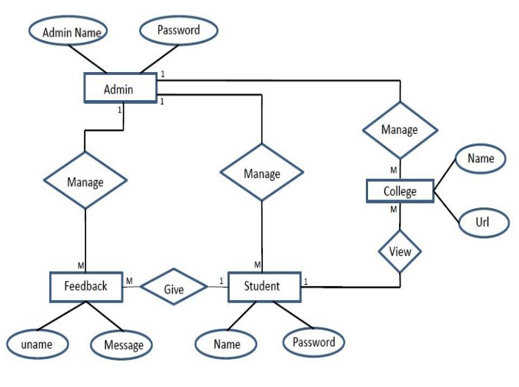
E-R Diagram :

Slide 6
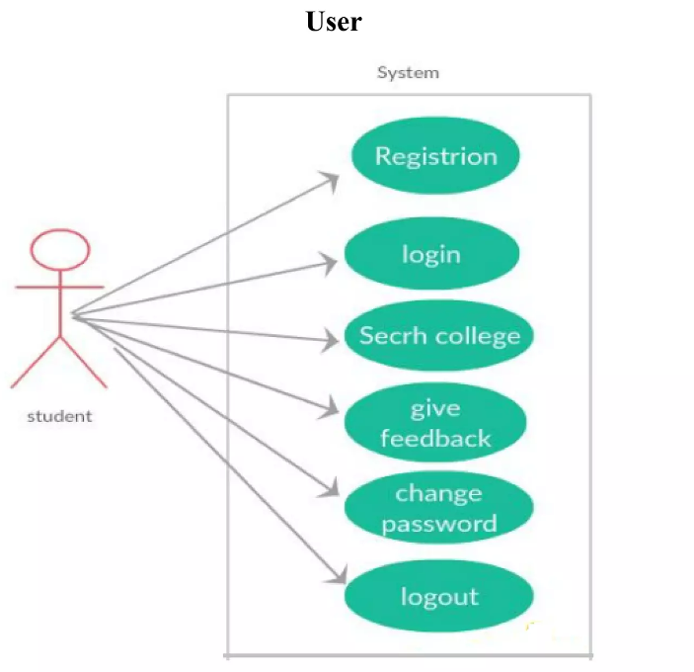
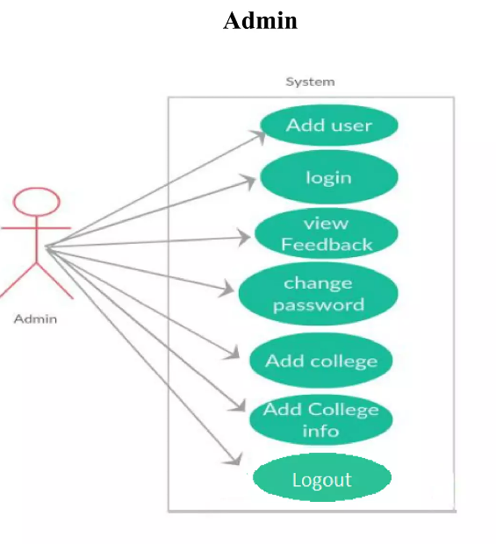
Use Case Diagram :

Slide 7
Modules Used :
Student Module
This module provide all the functionalities related to student. We need to develop
all types of (Create, Read, Update and Delete) operations of the student.
Features of Student Module :
Admin can add new student.
Only admin can edit and update the record of the student.
Admin will be able to delete the records of the student.
2) Event Module
All event will be managed by admin. Admin can see list of all the Event and filter it according to user.
Features of Event Module :
Admin can edit/delete the Event.
User can see the Event.

Slide 8
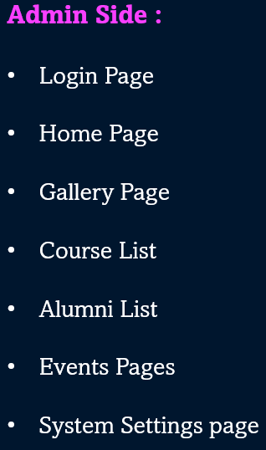
User Side :
Home Page
Signup Page
Login Modal
Gallery Page
About Page
Job Page
Forum Page​​​​​​​

Slide 9
Functionality performed by Project :
Login for admin
Forgot password for admin
Edit profile for admin
Logout Functionality
Dashboard for Admin User
Manage Student Manage Event
Adding new Student - Adding new Event
Edit the existing Student - Edit the existing Event
View details of the Student - View details of the Event
Reports
Report of all Student
Report of all Event

Slide 10
Technology used :
HTML : Page layout has been designed in HTML.
CSS : CSS has been used for all the designing part.
JavaScript : All the validation task and animations has been developed by JavaScript.
PHP : All the business and frontend logic has been implemented in PHP.
MySQL : MySQL database has been used as database for the project.

Slide 11
Conclusion & Future Scope :
This system will be available for general public use through the web interface.
The current implementation of this project provides the complete details of the alumni’s their current status and to establish contact with alumni. The alumni information system allows the new students to communicate with alumni’s each other.
Alumni system also solves the problem concerned with graduate’s feedback to the faculty with an inquiry module. In this module the faculty can define questions with answers which active graduates can respond.
This module should be used for collecting data which are not included in graduate’s profiles and have high information value for the faculty.

Slide 12
THANK YOU !

